Slide 1

Project 3
Zeke Herrera &
Nathan Dwyer
This Photo by Unknown author is licensed under CC BY-SA.

Slide 2

Objective
Our objective was to develop a Voting System by implementing a Solidity Contract, establishing a Python environment, and subsequently deploying our solution onto Streamlit for a comprehensive visualization of the final project. This approach encompasses the creation of a secure and transparent smart contract using Solidity, leveraging the versatility of Python for backend development and blockchain interaction, and employing Streamlit for intuitive user interface design and data visualization.

Slide 3
Overview
Solidity Contract Overview
Contract Functions and Operations
Solidity Contract Features
Setting up the Python Environment
Interacting with the Solidity Contract
Deploying Streamlit
Project Hurdles/Analysis
Questions

Slide 4
Solidity Contract Overview (Voting Contract)
Introduction to Solidity Contract:
The Solidity Contract serves as the foundation of the voting system which enables transparent, secure, and decentralized elections by managing voting registration, casting vote, and tallying results on the blockchain.
Contract Structure:
Pragma (pragma solididty ^0.5.5))
Import contracts to build off of ( ERC721Full)
Struct Voter to represent the individual voter in the voting system
Mapping to store the voter and candidate information
Constructor initializes the ERC721 token and enables ownership of voting rights on the blockchain
Function registerVoter to register voters
Function vote to allow employees to vote for candidates
Function viewResults to show election results

Slide 5
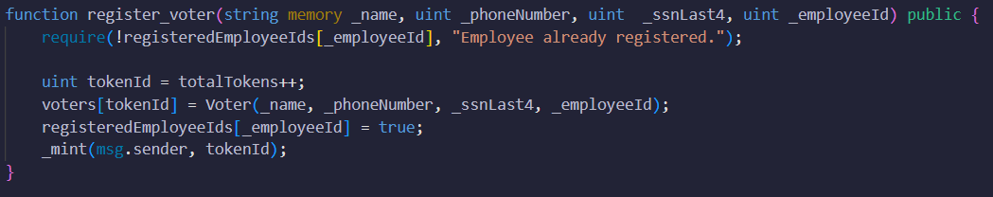
Contract Functions and Operations
Modifiers and Requirements: ERC 721Full Imports functionalities that were used for trading with NFT's
Registering Voters: First it takes the parameters _name, _phoneNumber, _ssnLast4, and _employeeId. Then the function creates the totalTokens variable which is used to assign a unique token ID to each employee. Then we create a 'Voter" struct with the provided parameters above which are then stored using the 'totalTokens' as the key. This allows a new token to be minted to the address of the sender (the employee) using the '_mint' function inherited from the ERC721FULL import.

Slide 6

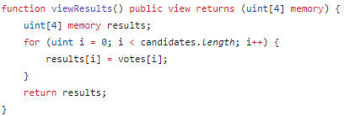
Contract Functions and Operations
Casting Votes: The vote function takes the parameters of the _tokenId and _condidateIndex to allow the employee to vote for their chose candidate. The require statement ensures that only the owner of the token can cast the vote and checks if the sender of the transaction is the owner of the token specified, if the condition comes back as false the function reverts back to an error message.
Viewing Results: The function loops through each candidate and retrieves their respective votes from the 'votes' mapping and then creates an array containing these counts and returns the results.

Slide 7
Solidity Contract Features
Token Issuance:
Upon registration a unique token is minted for each for which allows them to participate in the voting process.
Voting Functionality:
Registered voters can cast votes for one of the predefined candidates by specifying which candidate they would like to vote for.
Vote Tallying:
The contract maintains a tally of votes for each candidate, updating the vote count in real time as voting occurs.
Viewing Voting Results:
Anyone can view the current voting results , displaying the tally of votes for each candidate.
Inheritance from ERC721Full:
The contract inherits from the ERC721Full contract which provides functionality for managing non-fungible tokens which includes token creating, transfer and ownership.

Slide 8
Setting up Python Environment Preparing for Streamlit Development
Casting Votes:​ This allows registered voters to the voting functionality provided by Solidity contract by calling the 'vote' function.
Viewing Results:​ This function allows the user to view results from the Solidity contract through the 'viewResults' function in the contract.
Load imports, imports will depend on the needs on the project and can vary. For this project we did have to bring in Web3 and a Solidity contract so those are included in our python code as well.
Voter Registration: Is where the user initiate the voter registration process by calling the 'registerVoter' function provided by the Solidity contract

Slide 9
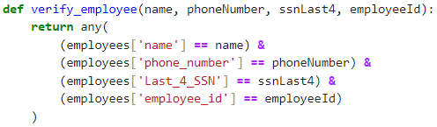
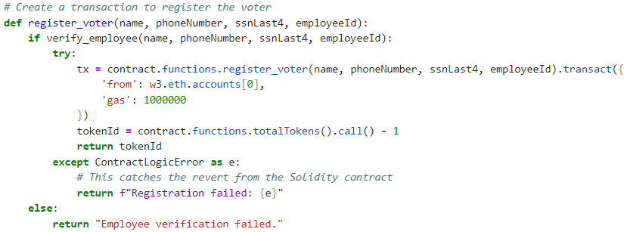
Interacting with Solidity Contract Backend Functions Empower Streamlit Development
Verifying Employee Information:
This function ensure only valid employee can register for voting by verifying their identity against the pre-existing employee database.
Registering Voters:
This function allows employees to votes after verifying eligibility through the verification step and generates a unique token for the newly registered employee.

Slide 10
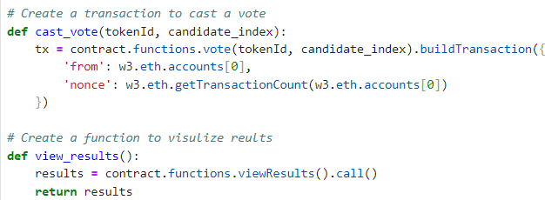
Interacting with Solidity Contract Part 2 Empower Streamlit Development
Casting Votes:
This function allows a registered voter to use a token to vote for a preferred candidate with their unique token.
Viewing Results:
This function allows users to monitor the voting process and stay tuned to see if their favorite candidate is leading the polls.

Slide 11
Deploying Streamlit Front End
Imported new time function
Imported functions from project_app2
register_voter, cast_vote, view_results, get_candidates
Created Timer
Created a Reister voter form
Created a vote form

Slide 12
Project Hurdles/Analysis
Governance Import
Trying to use the Governance Import became quite difficult as it would not allow us to deploy our contract unless we jumped through a myriad of hoops.
Voter Registration
When trying to register voters we ran into several hiccups including
CSV import issues
We had to convert float to int

Slide 13

Q&A

